Slide 1
Early Childhood Physical Development. How well is Nurture doing?
Presentation Summary – 16th June 2020
Dr L Hennessy
Notes:
Nature has provided a rich and powerful set of instructions within our DNA for our movement development. Here we consider how well nurture is doing in fulfilling this potential.

Slide 2
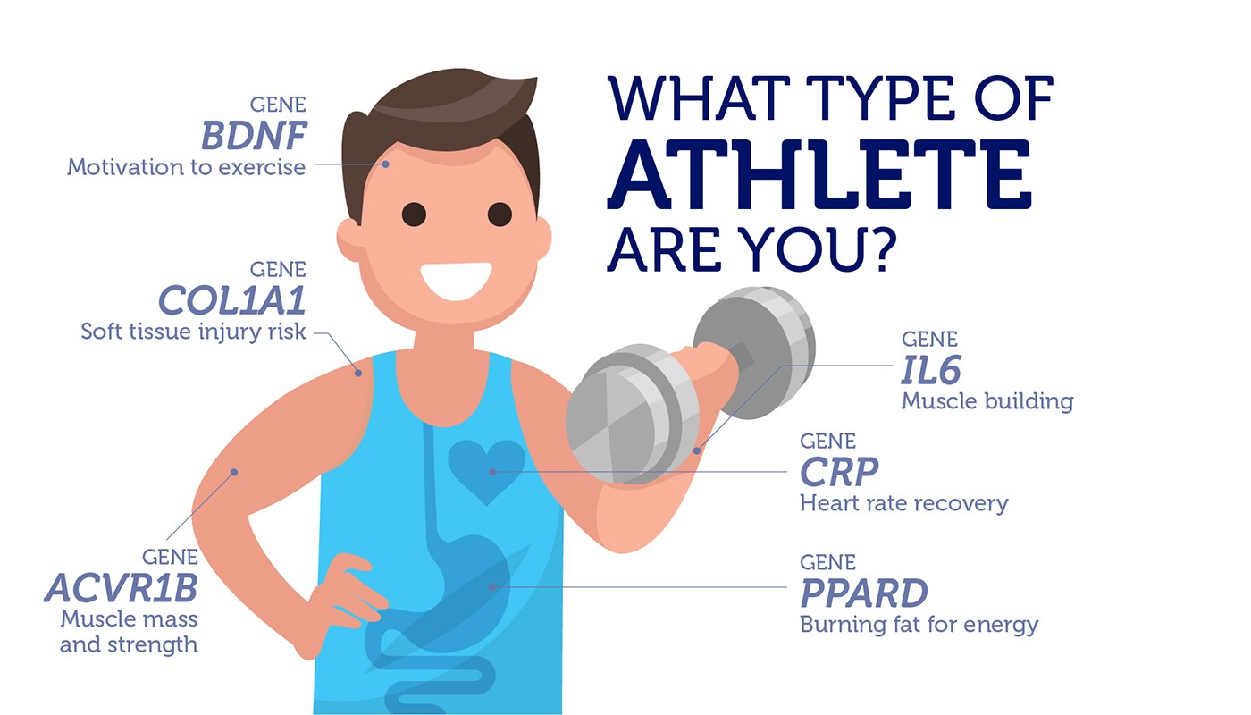
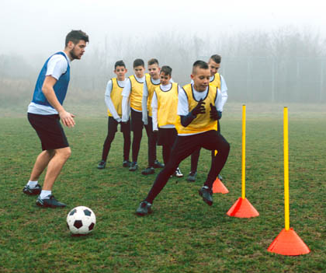
How well is Nurture doing in developing athleticism?
Nature endows….. Nurture responds……
Notes:
Nature provides us with a host of gifts and one of these is the gift of movement. Through movement we develop most if not all of our faculties. Movement is essential for developing our brain and with that for developing our emotions, our cognitive awareness, faculties. personality psycho– social skills and movement skills. Movement in the early years is central to this development. In general most discussions on long term athlete development start about considering what the child should be doing from about age 4 onwards, here we will ask a simple question: How well is nurture, that is nurture during the crucial early years, how is it doing in developing the gifts that nature provided. Put another way how well is Nurture doing in developing the building blocks for a healthy life and fulfilling life. Before answering let’s take a brief overview of this early development phase which links seamlessly, all going well, with the later Fundamental movement stages and continues the development journey throughout our lifespan.

Slide 3
Nature interacting with
Nurture:
Reflexive Phase: Year 1
Example ATNR
The asymmetrical tonic neck reflex occurs when the infant turns to the left (as in caption). The left side then extends while the elbow, knee and hip on the right-side flex. This trains hand-eye coordination and is a preparatory reflex for initiating a roll
Example: Crawl Reflex
Infants have a primitive crawling reflex at birth, which is instinctively activated when they are on their abdomens
Notes:
Nature guides the first few months of development through using reflexes. This is known as the Reflexive Phase and can last up to 6 months. During this phase a host of movements become refined from these primitive reflexes. One such reflex is the asymmetrical tonic neck reflex which sets the base for later coordinated movements. Note the classical posture of the fencer here in the caption. One side flexes while the gazing side extends. This prepares the infant for later hand-eye coordination development. Also the Crawl reflex is stimulated when the baby lies on their tummy – this prepares the infant for crawling. These and other primitive reflexes are the first steps in the building blocs required for later rudimentary movements.
The Rudimentary phase in the next one in the developmental journey that the infant now child starts. We see this when the child starts to sit without support, and starts to grasp objects and then starts to roll, creep and crawl. These rudimentary movements have actually been successfully used by therapists and coaches for improving movement control and balance in mature athletes (Janda 1984, Page et al 2010, Gill et al 2009). These are seen by many experts as key building blocks for soon to come fundamental skills of locomotion, coordination, manipulation and awareness. Note that the Rudimentary phase links with the early Fundamental Movement Phase in and around 3 years of age for most children.
Throughout the early years the child, in an ideal world, will be exposed to a range of playful activities that include rudimentary and fundamental movement skills and activities. The types pf play that are evident from infancy include solitary play, spectator play, and from about 2 to 2 and a half years of age parallel, associative and then cooperative play from about 4 years of age onwards. They may not always be so uniquely individualised but all these types of play should be seen and evident within the child’s home and wider environment such as in play schools as he or she matures from 2 to about 4 years of age. Co-Operative play is one which holds huge potential for developing the Fundamentals as well as other improitant psycho-social and emotional faculties. It would be grate to see more of these playful activities across all phases of sport. The net effect is that the different types of play all contribute to a rich base of development that is not just physical movement development but also emotional, social and cognitive for the growing child. However, in a world where sitting time and screen time is now dominant (Felix et al (2020, Vale et al 2020) this important source of movement through play development is now threatened more than ever and has been so for several years (Brown 2010, Ratt.

Slide 4
24 Hour Movement Guidelines - Early years
(Mota et al 2020, Cliff et al 2017, Chaput et al 2017)
Av: 11%
Notes:
In response to the growing awareness of the importance of gaining daily physical movement within the early years, an international initiative was created in 2017 and called the 24 hour Movement. During the 3 years of this initiative several international reports have shown that we are still a long way from delivering a balanced daily routine across PA, ST and Sleep for the child. The bottom line here is that Nurture is not doing well. This can be seen in the accompanying slide. Note this is a brief summary of 3 main studies from Australia, Canada and Portugal and highlights the variance within each of the 3 main activities across these countries. In the graph note that between 30% and 90% of children across these 3 countries attain the recommended 180 minutes of PA each day. With respect to Sleep between 80% and 90% attain the required sleep time from 10 to 13 hours a day. However, with respect to Screen Time no more than 3 children out of 10 adhere to a recommended under 60 minutes per day on screen time. The interaction of all three activities has also shown that excessive screen time is associated with poor motor skills and increased physical inactivity in children (Felix et al 2020). Also note that when we average out the percentage of children who meet all 3 activity recommendations, we get a very poor 11% compliance.
Shayne will discuss in more detail the FMS phase but it is of interest here to note that when we add the finding that FMS are indeed at a low level across the majority of children within several countries, as they move from early childhood to later childhood, we can argue that NURTURE is not fulfilling the potential that NATURE has endowed within children. Recent evidence from an Irish study on children between 5 and 13 years of age, shows that 78% of children scored very poor or below average FMS levels when assessed using the Test of Gross Motor Development – 2. This is broadly in line with evidence from other countries (Behan et al 2018, Hardy et al 2009, Morley et al 2015). Coupled with the findings that cardiovascular fitness has shown a decline with some stabilisation over the last 40 years suggests that the overall physical competence and fitness of children is a concern (Tomkinson et al 2017). However, the reality is that it does not take a lot to improve fundamental movement skills as Keith Costello and Dr Joe Warne recently reported when they showed that even a short 4 week school based programme could measurably improve a child’s FMS level.
So while we disappointingly give a low grade to our efforts at supporting a thriving environment for a child’s development there is a positive side, and that simply relates to the fact that a child’s movement skills and fitness can be readily improved through simple but well planned interventions. Experience and the accumulating evidence tells us that it is important that interventions and initiatives have sustained support and collaboration from parents, schools communities and sport organisations as well as local and central government. It is arguably that only through such collaboration that a thriving environment can be created. Unfortunately, we are struggling in this but with awareness of the recent findings from the 24 Hour Movement reports, collaboration and support can occur.

Slide 5
Our Challenges
Increasing holistic approach to Physical Activity – especially coaching of Rudimentary and FMS as well as encouraging free Play from 2/3 onwars
Moderating Screen Time
- Parents VIP in this
Promoting 24 hour Movement Guidelines through all agencies – Parents, playSchool, sport Associations
Sport to create/encourage and monitor FMS and Play programme
Notes:
So we can confidently state that children’s development in terms of FMS and other important social, emotional and cognitive traits are not being optimised by any means.
As a result, the challenges are numerous for us: Here in this graph we summarise some of these challenges as they relate to assisting nature achieve its mission over the early formative years. We can justifiably state that improving a more balanced lifestyle within our children at a tender early age which includes moderating screen time and promoting more physical play that is at least moderately vigorous to vigorous at times, that this will develop more than just movement abilities and will it is argued, provide a greater opportunity in developing what nature intended to bestow to the child. Now the challenge is up to its poorly performing relative – nurture, that is the adults who oversee the nurturing environment.

